Slide 1
Risk Sharing Between Households and Financial Institutions in Credit Downturns
Dilyana Dimova
International Monetary Fund

Slide 2
A story from the trenches… … of the sub-prime mortgage crisis
In 2004, Edmund Andrews, an economic reporter for The New York Times, purchased a house and obtained his mortgage despite having modest disposable income and putting down very little downpayment…
…However, his mortgage was a classic subprime loan. The monthly payment first jumped from $2,500 to $3,700, and then ratcheted up to $4,500...
…After his wife lost her job, he fell behind on his bills and defaulted.
However, he was far from being the only one...
…In fact, he had outlived two of his three mortgage lenders…
…The first one collapsed overnight when the financial markets first froze up in August 2007…
…The second one was forced out of the mortgage business by federal regulators.

Slide 3
After the Sub-prime Mortgage Crisis…
Banks have been bailed out relatively fast…
Bank of America, Citigroup, JP Morgan Chase, Wells Fargo were among those which received a total of $245 billion in TARP funds.
Most banks have repaid back TARP.
But consumers have been faced with a protracted recovery…
Consumer lending has yet to reach pre-crisis rates.
Some of this reflects improving standards - 56.3% of banks reported in a Fed survey that they had tightened lending to borrowers with weak credit histories.
But the Fed survey found that 14.3% of the banks have tightened lending on prime loans to borrowers with strong credit histories.

Slide 4
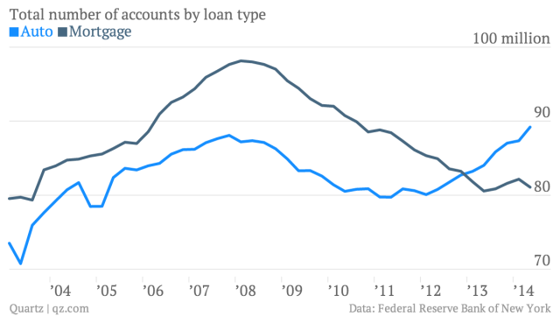
Consumer Mortgage Lending

Slide 5
This Model
The model develops a two-sector economy with mortgages and financial frictions in both the consumer and financial sectors (following Bernanke, Gertler and Gilchrist, 1999; and Hirakata, Sudo and Ueda, 2009).
Credit-constrained households cannot finance their housing acquisition on their own so they obtain a mortgage.
Financial institutions have no equity on their own and borrow to lend to consumers.
Both financial institutions and consumers are leveraged and enter into two loan contracts that are chained.
Since banks optimize the chained loan contracts there are opportunities for risk sharing where banks shift some of the downturn onto indebted consumers in order to hasten their own recovery.

Slide 6
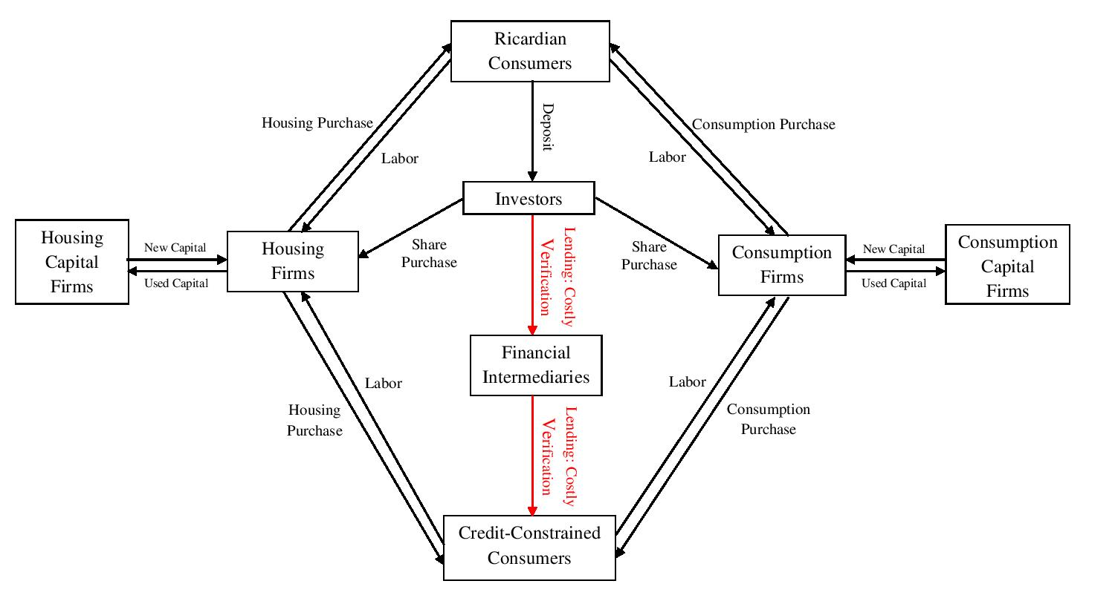

Slide 7
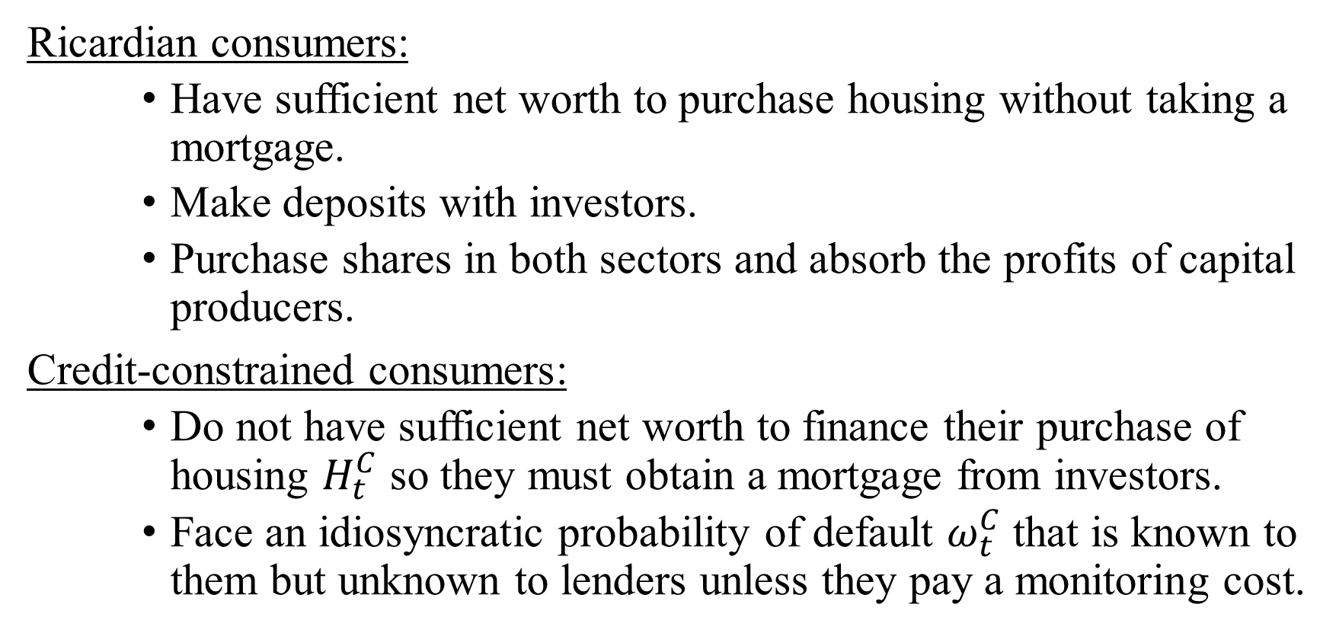
Two Types of Consumers
Ricardian consumers:
Have sufficient net worth to purchase housing without taking a mortgage.
Make deposits with investors.
Purchase shares in both sectors and absorb the profits of capital producers.
Credit-constrained consumers:
Do not have sufficient net worth to finance their purchase of housing $H_{t}^{C}$ so they must obtain a mortgage from investors.
Face an idiosyncratic probability of default $ω_{t}^{C}$that is known to them but unknown to lenders unless they pay a monitoring cost.

Slide 8
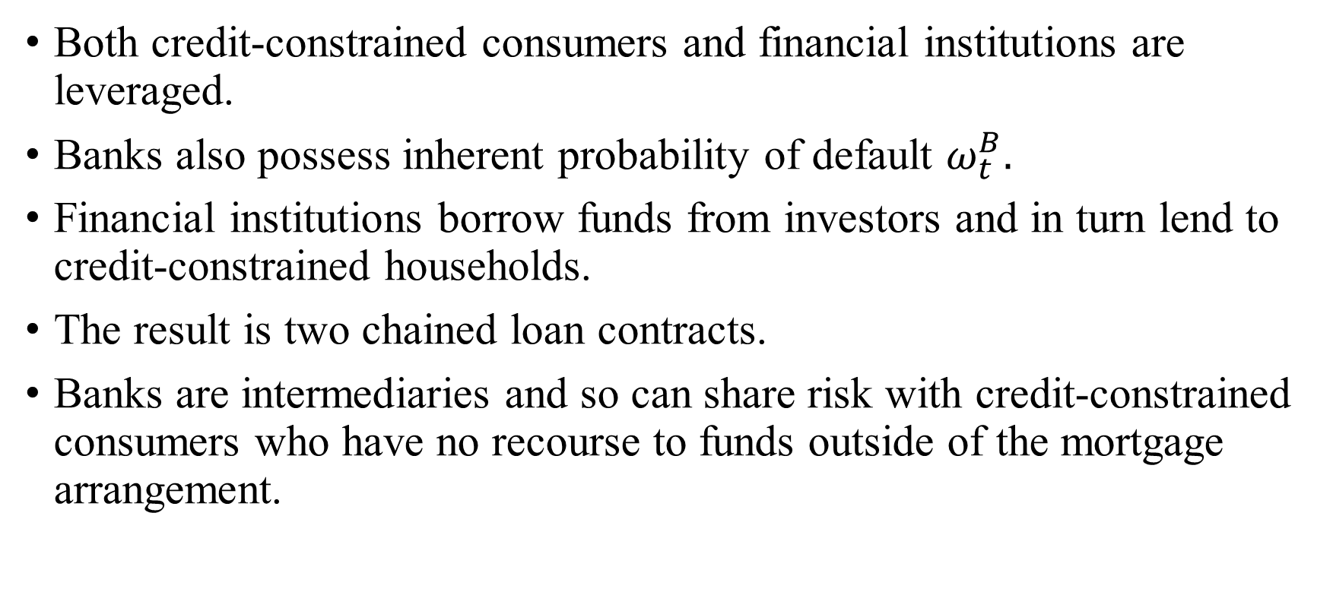
The Chained Loan Contracts
Both credit-constrained consumers and financial institutions are leveraged.
Banks also possess inherent probability of default $ω_{t}^{B}.$
Financial institutions borrow funds from investors and in turn lend to credit-constrained households.
The result is two chained loan contracts.
Banks are intermediaries and so can share risk with credit-constrained consumers who have no recourse to funds outside of the mortgage arrangement.

Slide 9
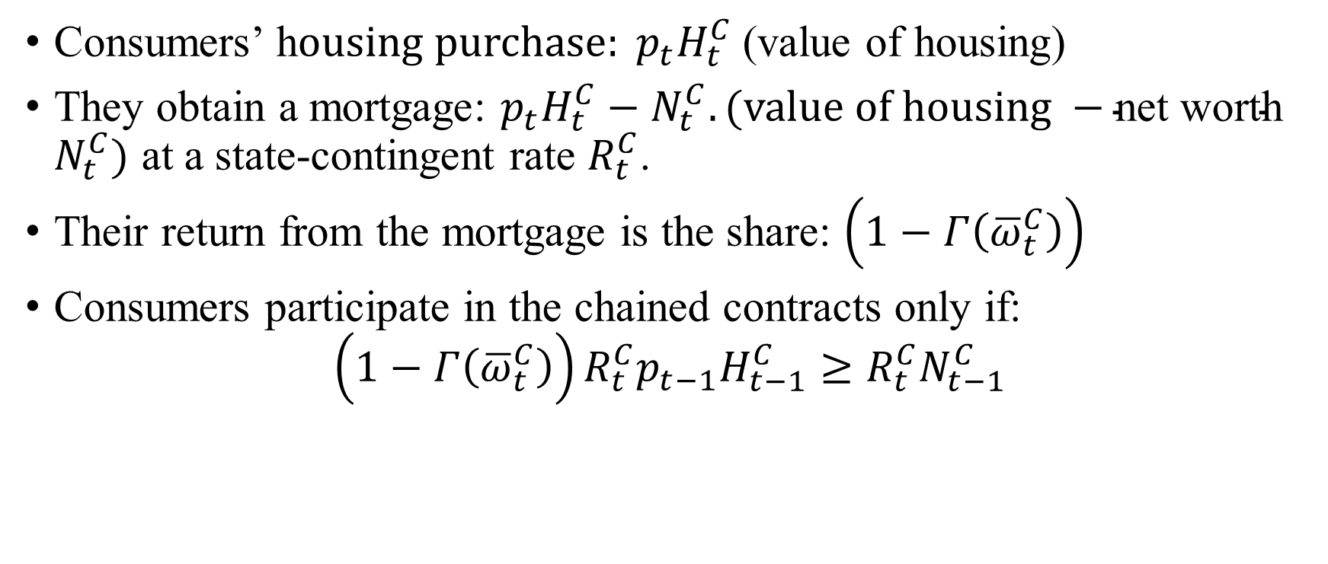
The Chained Mortgage Contracts: Credit-Constrained Consumers
Consumers’ h$ousing purchase: p_{t}H_{t}^{C}$(value of housing)
They obtain a mortgage: $p_{t}H_{t}^{C}−N_{t}^{C}. (value of housing −\text{net} \text{worth} N_{t}^{C})$ at a state-contingent rate $R_{t}^{C}$.
Their return from the mortgage is the share: $\left(1−Γ\left({\overline{ω}}_{t}^{C}\right)\right)$
Consumers participate in the chained contracts only if:
$$\left(1−Γ\left({\overline{ω}}_{t}^{C}\right)\right)R_{t}^{C}p_{t−1}H_{t−1}^{C}≥R_{t}^{C}N_{t−1}^{C}$$

Slide 10
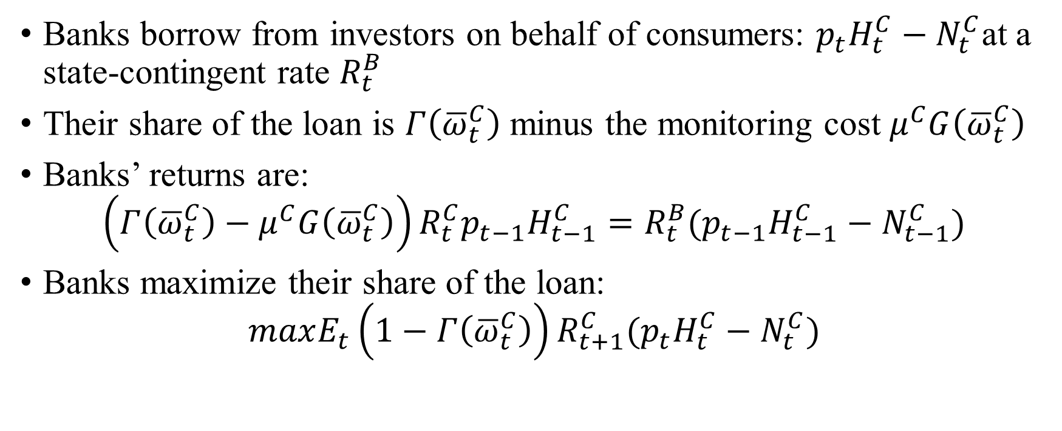
The Chained Mortgage Contracts: Financial Institutions
Banks borrow from investors on behalf of consumers: $p_{t}H_{t}^{C}−N_{t}^{C}$at a state-contingent rate $R_{t}^{B}$
Their share of the loan is $Γ\left({\overline{ω}}_{t}^{C}\right)$ minus the monitoring cost $μ^{C}G\left({\overline{ω}}_{t}^{C}\right)$
Banks’ returns are:
$$\left(Γ\left({\overline{ω}}_{t}^{C}\right)−μ^{C}G\left({\overline{ω}}_{t}^{C}\right)\right)R_{t}^{C}p_{t−1}H_{t−1}^{C}={R_{t}^{B}(p}_{t−1}H_{t−1}^{C}−N_{t−1}^{C})$$
Banks maximize their share of the loan:
$$maxE_{t}\left(1−Γ\left({\overline{ω}}_{t}^{C}\right)\right){R_{t+1}^{C}(p}_{t}H_{t}^{C}−N_{t}^{C})$$

Slide 11
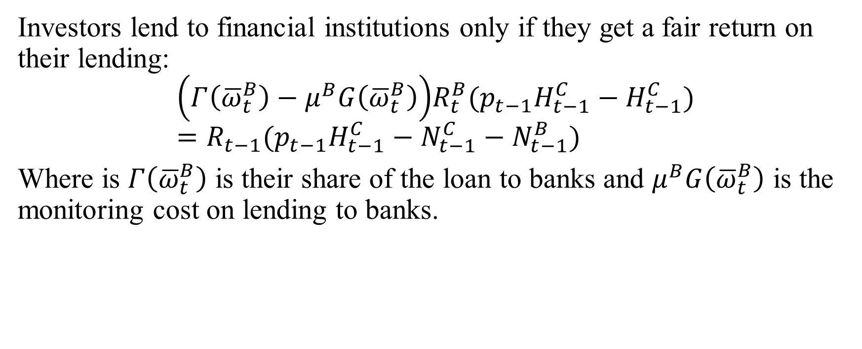
The Chained Mortgage Contracts: Investors
Investors lend to financial institutions only if they get a fair return on their lending:
$$\left(Γ\left({\overline{ω}}_{t}^{B}\right)−μ^{B}G\left({\overline{ω}}_{t}^{B}\right)\right)R_{t}^{B}{(p}_{t−1}H_{t−1}^{C}−H_{t−1}^{C})={R_{t−1}(p}_{t−1}H_{t−1}^{C}−N_{t−1}^{C}−N_{t−1}^{B})$$
Where is $Γ\left({\overline{ω}}_{t}^{B}\right)$ is their share of the loan to banks and $μ^{B}G\left({\overline{ω}}_{t}^{B}\right)$ is the monitoring cost on lending to banks.

Slide 12
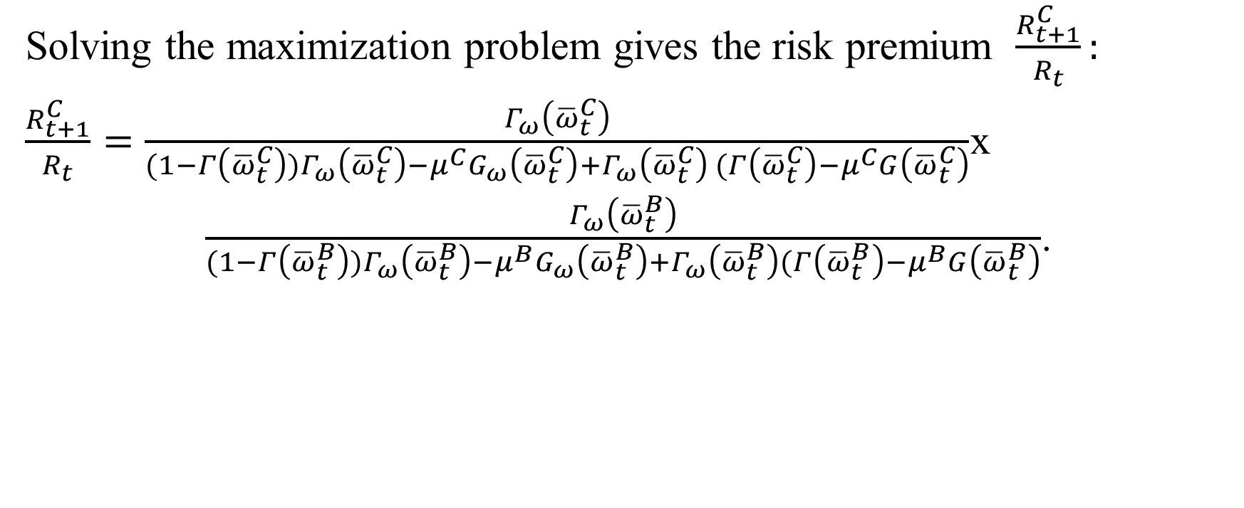
Solution to the Chained Mortgage Contracts
Solving the maximization problem gives the risk premium $\frac{R_{t+1}^{C}}{R_{t}}:$
$\frac{R_{t+1}^{C}}{R_{t}}=\frac{Γ_{ω}\left({\overline{ω}}_{t}^{C}\right)}{(1−Γ\left({\overline{ω}}_{t}^{C}\right))Γ_{ω}\left({\overline{ω}}_{t}^{C}\right)−μ^{C}G_{ω}\left({\overline{ω}}_{t}^{C}\right)+Γ_{ω}\left({\overline{ω}}_{t}^{C}\right) (Γ\left({\overline{ω}}_{t}^{C}\right)−μ^{C}G\left({\overline{ω}}_{t}^{C}\right)}$x
$\frac{Γ_{ω}\left({\overline{ω}}_{t}^{B}\right)}{(1−Γ\left({\overline{ω}}_{t}^{B}\right))Γ_{ω}\left({\overline{ω}}_{t}^{B}\right)−μ^{B}G_{ω}\left({\overline{ω}}_{t}^{B}\right)+Γ_{ω}\left({\overline{ω}}_{t}^{B}\right)(Γ\left({\overline{ω}}_{t}^{B}\right)−μ^{B}G\left({\overline{ω}}_{t}^{B}\right)}$.

Slide 13
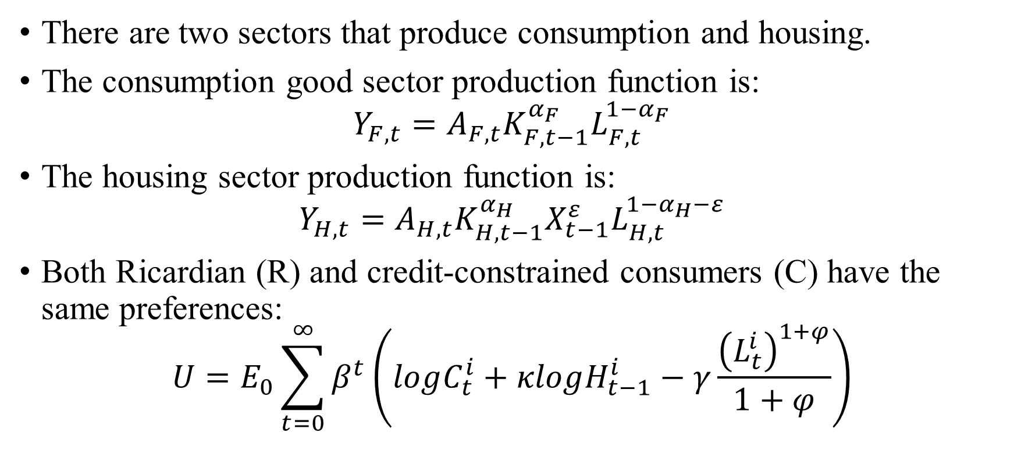
The Complete Economy
There are two sectors that produce consumption and housing.
The consumption good sector production function is:
$$Y_{F,t}=A_{F,t}K_{F,t−1}^{α_{F}}L_{F,t}^{{1−α}_{F}}$$
The housing sector production function is:
$$Y_{H,t}=A_{H,t}K_{H,t−1}^{α_{H}}X_{t−1}^{ε}L_{H,t}^{{1−α}_{H}−ε}$$
Both Ricardian (R) and credit-constrained consumers (C) have the same preferences:
$$U=E_{0}\sum_{t=0}^{∞}{β^{t}\left(logC_{t}^{i}+κlogH_{t−1}^{i}−γ\frac{{\left(L_{t}^{i}\right)}^{1+φ}}{1+φ}\right)}$$

Slide 14
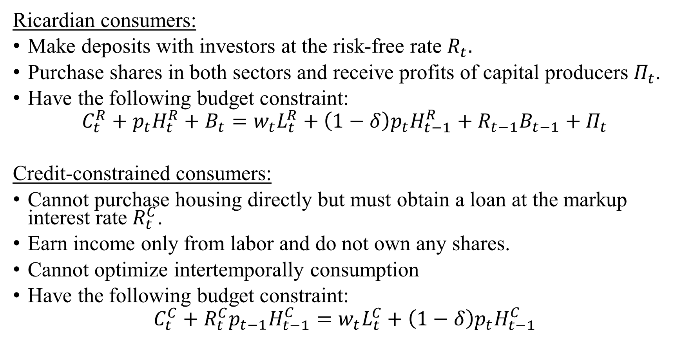
Consumers
Ricardian consumers:
Make deposits with investors at the risk-free rate $R_{t}.$
Purchase shares in both sectors and receive profits of capital producers $Π_{t}$.
Have the following budget constraint:
$$C_{t}^{R}+p_{t}H_{t}^{R}+B_{t}=w_{t}L_{t}^{R}+\left(1−δ\right)p_{t}H_{t−1}^{R}+R_{t−1}B_{t−1}+Π_{t}$$
Credit-constrained consumers:
Cannot purchase housing directly but must obtain a loan at the markup interest rate $R_{t}^{C}$.
Earn income only from labor and do not own any shares.
Cannot optimize intertemporally consumption
Have the following budget constraint:
$$C_{t}^{C}+{R_{t}^{C}p}_{t−1}H_{t−1}^{C}=w_{t}L_{t}^{C}+\left(1−δ\right)p_{t}H_{t−1}^{C}$$

Slide 15
The Emergence of Risk Sharing
Financial institutions maximize the chained loan contracts so in times of downturn they transfer some of their leverage worsening onto households.
Risk sharing occurs because credit-constrained consumers have no recourse to outside funds.
With risk sharing, consumers face a more protracted recovery.
As lax credit dries up, financial institutions struggle to repair their debt position at the expense of consumers whose borrowing ability is squeezed for a long period.
The outcome mirrors the recent subprime mortgage crisis.

Slide 16
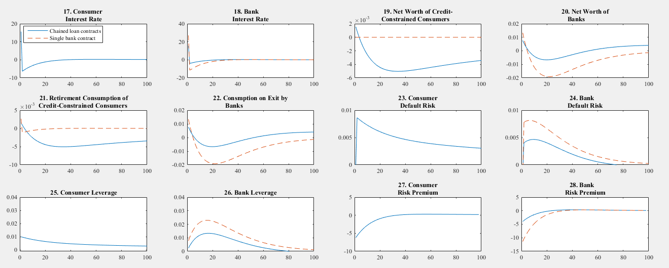
Eased Borrowing for Consumers

Slide 17
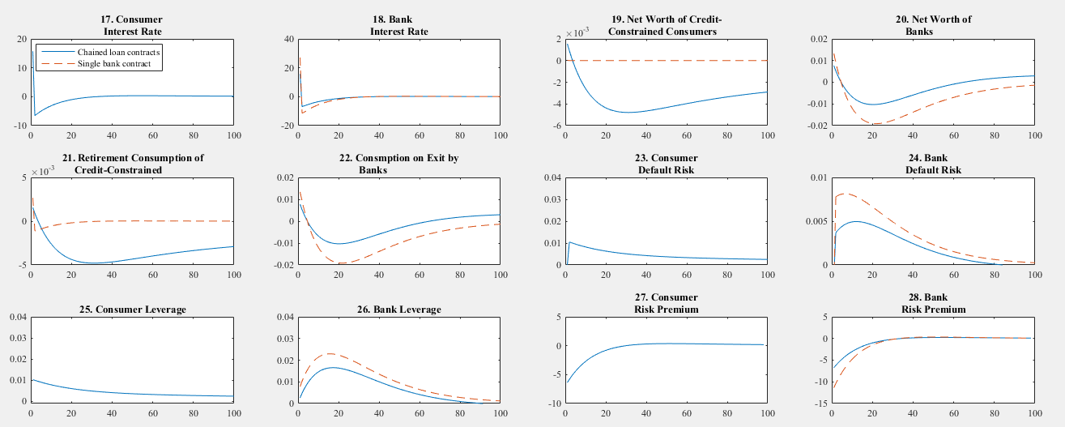
Eased Borrowing for Financial Institutions

Slide 18
Takeaway
Both simulations show that consumers fare worse when they participate in chained loan contracts with financial institutions.
Banks act as monopolists and shift some of the downturn to consumers.
Their recovery is partly at the expense of consumers.
Regulations may also need to protect consumers since…
Bailouts for consumers do not exist because they are “too small and too many.”
Future studies can address the presence of multiple banks and heterogeneous consumer behavior.

